Slide 1
Chapter 2
Nature of Matter

Slide 2
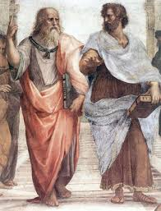
2.1 Nature of Matter
Atoms- Nearly 2500 years ago Democritus, a student of Aristotle, asked “Is something still the same after you break it in half, and is there a limit to how many times it can be broken down?”. Democritus thought there was a limit and coined the term atomos, or indivisible.
The term atom today is the basic unit of matter.

Slide 3
What makes up an atom?
Protons and neutrons are both located in the nucleus of an atom and have roughly the same mass.
Protons- positive charge (+)
Neutrons- neutral charge
Electrons have relatively little mass and are always moving around the nucleus
Electrons have a negative charge (-)

Slide 4
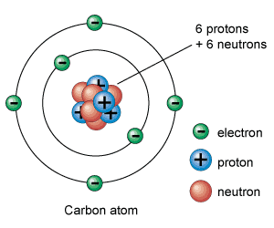
Model of an Atom

Slide 5
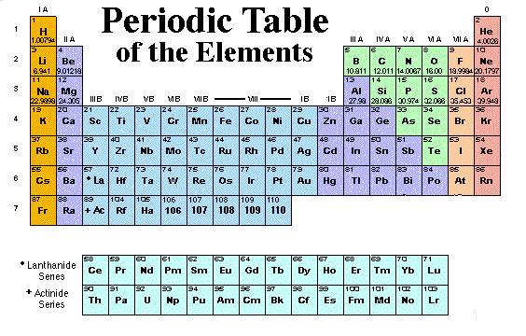
Element -A chemical element is a pure chemical substance consisting of one type of atom.

Slide 6
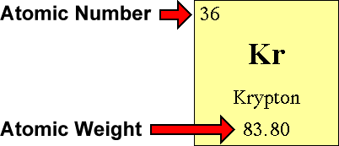
The atomic number of an element is the number of protons in the nucleus of an atom of that element.
The atomic mass is the total number of protons and neutrons in an atom.

Slide 7
Isotopes
Isotopes are atoms of the same element having a different number of neutrons.
Isotopes can be used by scientists to study the age of rocks, in medicine to treat cancer, kill bacteria, and as “tracers” to follow substances through an organism.

Slide 8
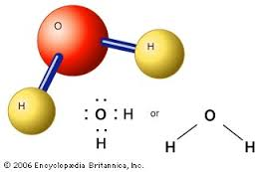
Chemical Compounds
Different atoms combine in definite ratios to form compounds.
For example water is made of 2 hydrogen atoms and 1 oxygen atom to produce a molecule of water H2O.

Slide 9
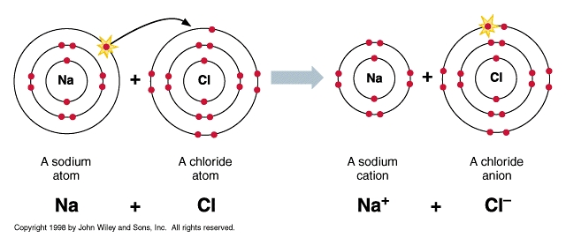
Chemical Bonds
Ionic Bonds- ionic bonds form when one metal atom loses electrons to another non-metal atom and a difference in charge attracts the ions or charged atoms together.

Slide 10
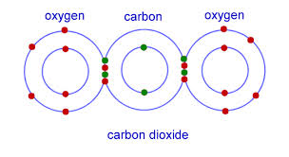
Chemical Bonds
Covalent Bonds- covalent bonds form when two non-metal atoms share electrons between them to form a molecule.

